Slide 1
Evolutionism
Evolutionism is a set of ideas or doctrine concepts of Evolution. It is a sequential, directional, and gradual occurring process. It is the process of systematic change. In cultural and social anthropology the gradual, structural change of human culture is the subject of study by evolutionists.
Evolutionism dominated anthropological thinking mainly during the latter part of 19th century. In fact, some argue that the growth of anthropology as a science is tied up with the development of the doctrine of evolution; neither could have developed with out the other (Calverton, 1931).
The 19th-century evolutionary theory in anthropology had especially two prominent proponents, who developed what is termed as unilineal evolution. These were Edward B. Tylor and Lewis Henry Morgan. Unilineal evolution is the view that societies evolve in a single direction toward complexity, progress, and civilization.

Slide 2
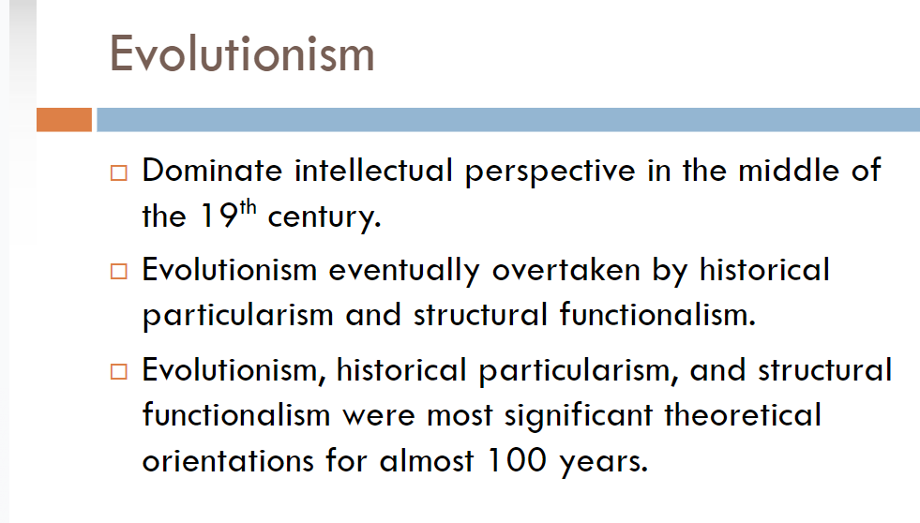
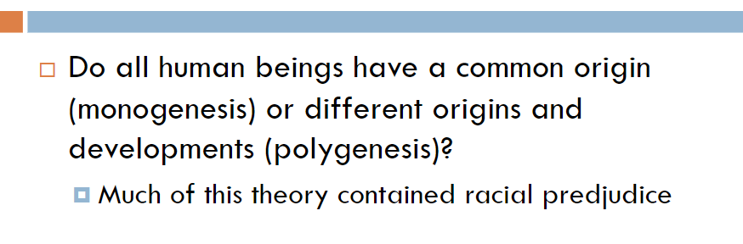

Slide 3
Diffusionism
Diffusionism developed in early part of 20th century; it was also interested in explaining why societies are at similar or different stages of development. This theory maintained that societal change occurs when societies borrow cultural traits from one another. Cultural knowledge regarding technology, economy, religious views, etc, diffuses or spreads from one society to another.
This may explain the similarities in cultural features between societies. Some extreme line of thought in this theory, called the British diffusionism, argued that all sorts of civilization originated in Egypt and spread to other societies. The weakness of this theory, like evolutionism, was that it was ethnocentric in its assumptions.
The diffusionists believed that nonwestern societies are inherently inferior, saying that these peoples are not innovative in creating civilizations. However, diffusionism has some validity in that it helps to explain the emergence of classical civilizations such as those in Egypt, Greece, and Rome (Howard and Dunaif-Hattis, 1992; Scupin and DeCorse, 1995).

Slide 4
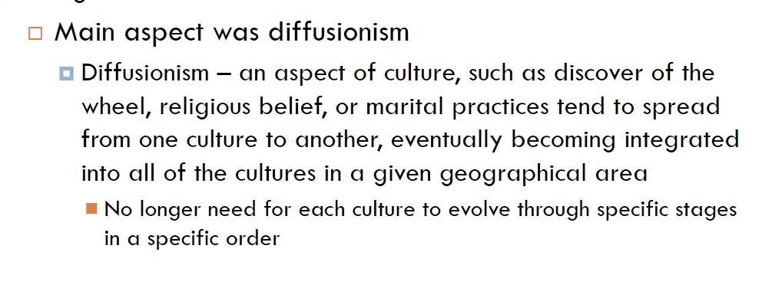

Slide 5
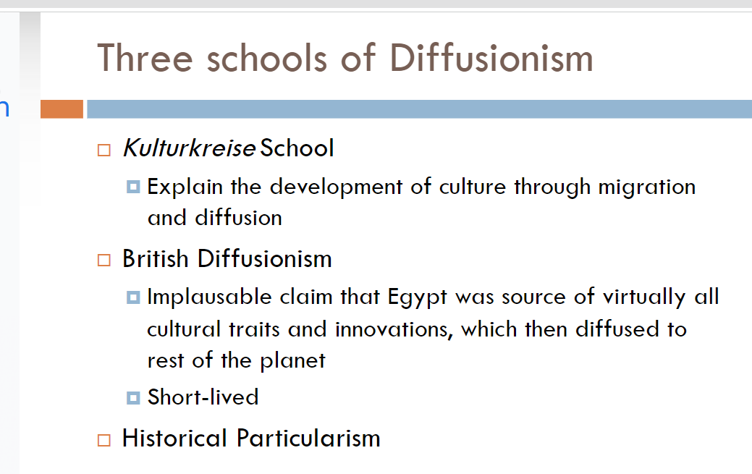

Slide 6
Historical Particualrism
This theory developed in early 20th century mainly in reaction to unilineal evolution. An American anthropologist, named Franz Boas, pioneered it. This theory provided an alternative to the question of why societal differences and similarities exist. Boas greatly influenced the development of anthropology in the 20th century.
He strongly opposed the unilineal evolutionary theory, and advanced the need for empirical field-based ethnographic research to explain and understand each society and culture in its historical contexts. Historical Particualrism thus maintains that each society has its own particular historical development. This view led to the development of the idea of cultural relativism

Slide 7
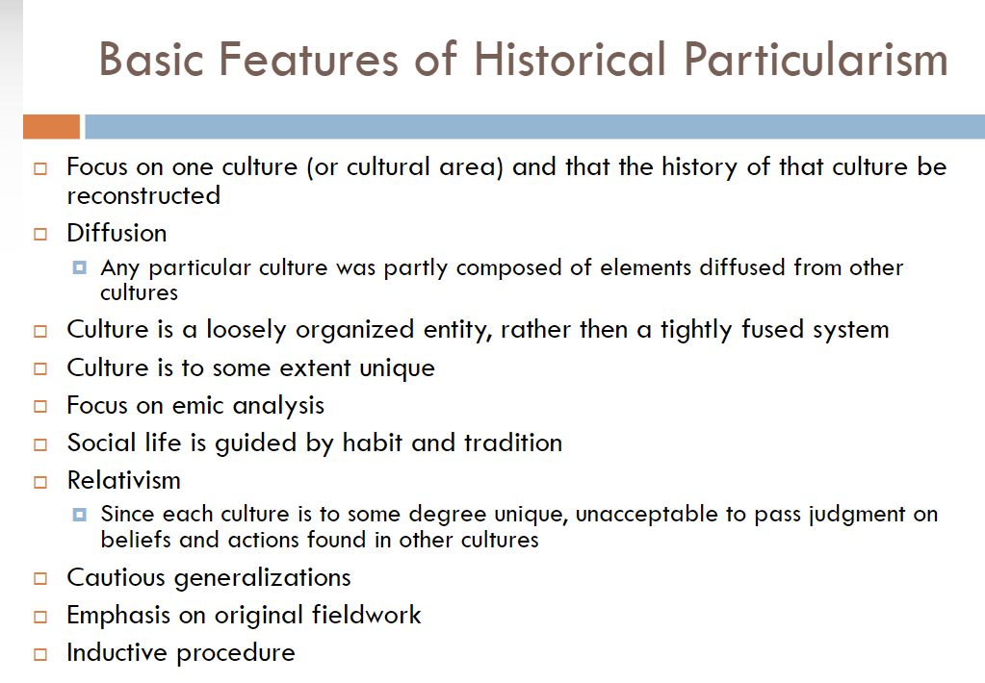

Slide 8
Functionalism
This perspective is one of the dominant theories both in sociocultural anthropology and sociology. The theory regards culture as an integrated whole (Howard and Dunaif-Hattis, 1992), and tries to explain how the relationships among the parts of society are created and how these parts are functional (meaning having beneficial consequences to the individual and the society) and dysfunctional (meaning having negative consequences).
The theory sees society as a complex system whose parts work together to promote solidarity and stability; it states that our social lives are guided by social structure, which are relatively stable patterns of social behavior (Macionis, 1997).
All social structures contribute to the operation of society. Two dominant British anthropologists in functionalism were Radcliff Brown and Bronslaw Malinowski, representing two strands in the theory: structural functionalism, which stresses the preeminence of society and its structure over the individuals, and how the various elements of the social structure function to maintain social order and equilibrium; and psychological functionalism, which stresses individual needs to be met by society.
The weakness of functionalist theory was that it failed to explain why societies different or similar. Functionalist anthropology assumed an orderly world, paying little or no attention to competition and conflict (Howard and Dunaif-Hattis, 1992).
The theory was ahistorical, neglecting historical processes. (Scupin and DeCorse, 1995) The theory was also unable to explain social and cultural change, as it viewed society as stable and unchanging. Despite these weaknesses, functionalism influenced a great deal of empirical research in anthropology

Slide 9
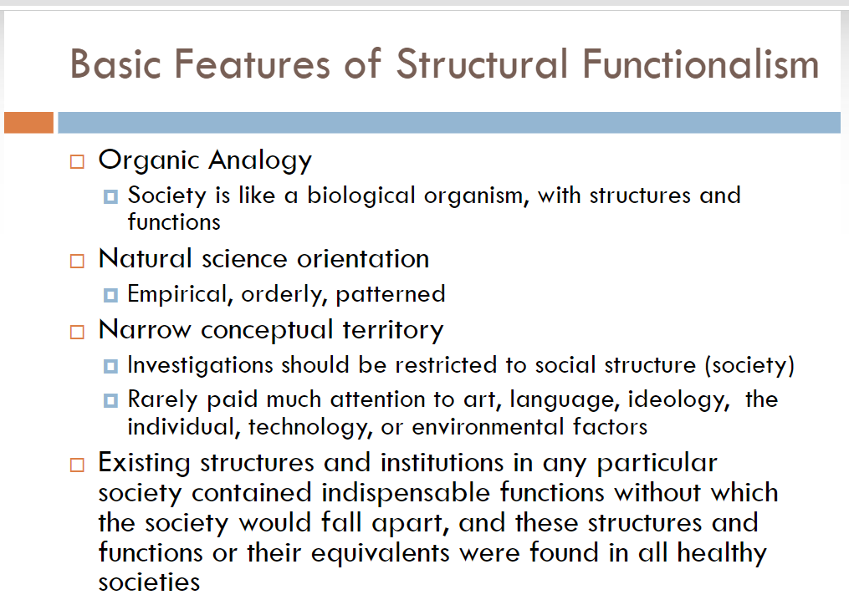
.

Slide 10
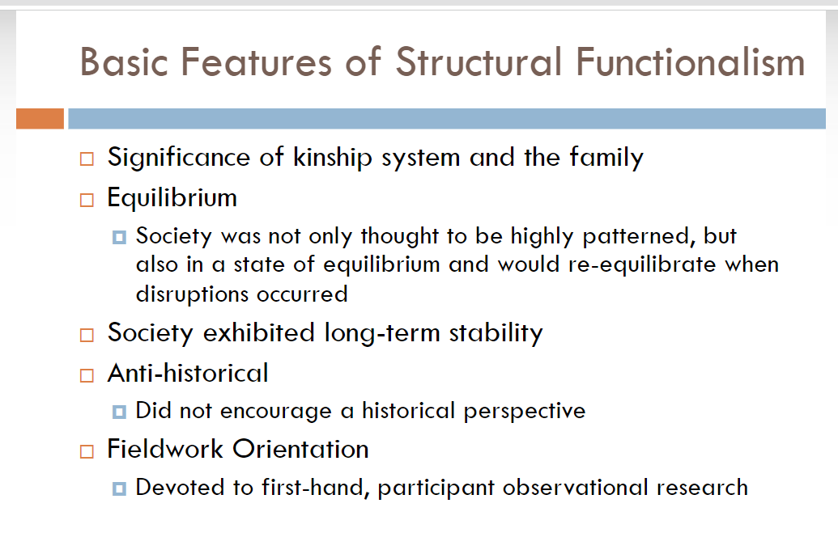

Slide 11
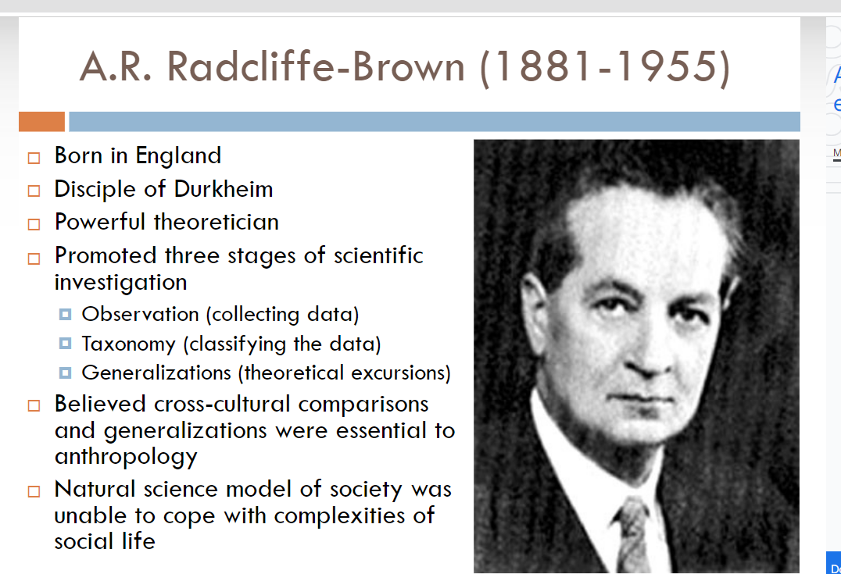

Slide 12
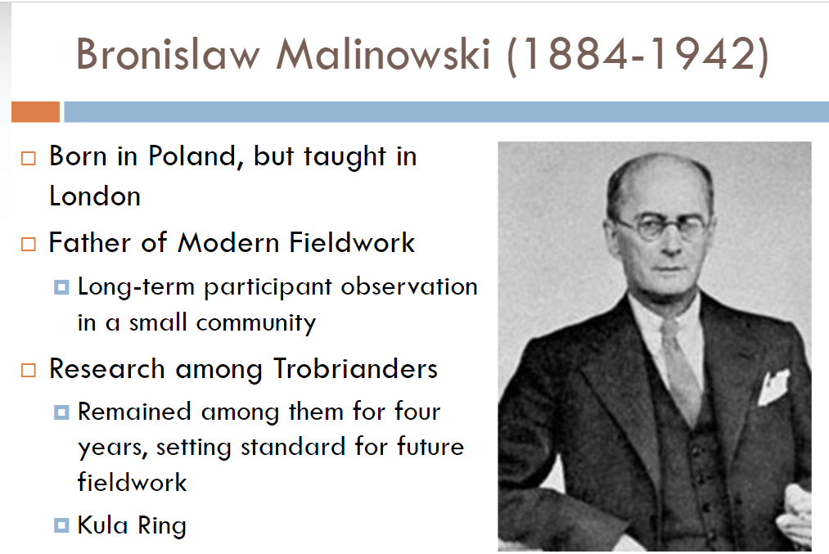

Slide 13
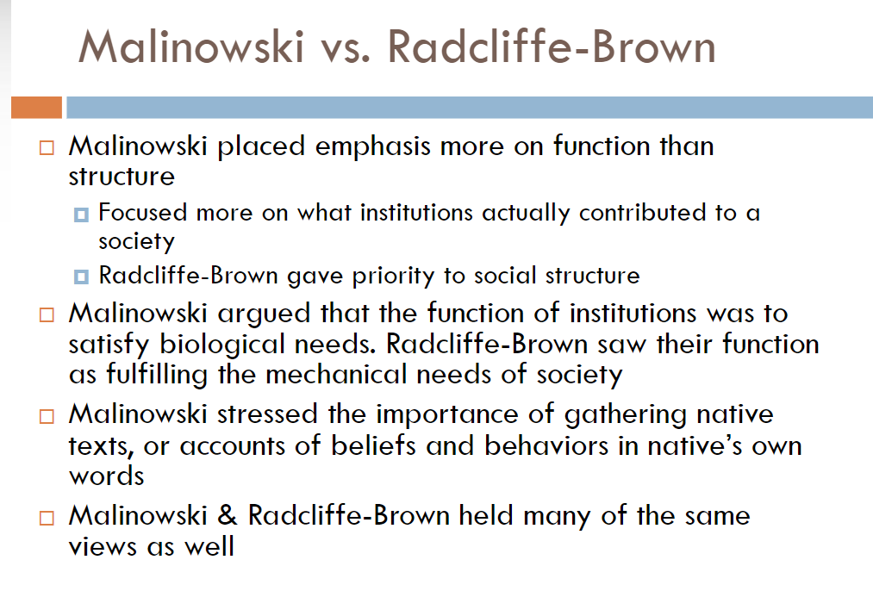

Slide 14
https://getuplearn.com/blog/theories-in-sociocultural-anthropology/

